Slide 1
Family Funfair

Slide 2
CONTENTS
TITLE
FLOW OF WEB PAGE
OBJECTIVES
APPLICATION
INDIVIDUAL CONTRIBUTION

Slide 3
Flow of Web Page:
FOOD
LOGIN HOME ACTIVITIES
TICKET
CONTACT

Slide 4
OBJECTIVES:
Learn the concept of html.
Learn the implementation of html in a effective manner.
Learn the use of CSS and JavaScript and its implementation.
Learn to develop webpages.
Learn the linking of webpages with each other.

Slide 5
APPLICATION
It can be used to organize funfair event.
With some minor changes it can be used to organise other events also,
Online ticket booking

Slide 6
Individual Contribution:
Home page:
In the home page we have used several basic HTML elements. Some of them are explained below:
Top nav bar: A navigation bar needs standard HTML as a base. In our examples we will build the navigation bar from a standard HTML list. A navigation bar is basically a list of links, so using the <ul> and <li> elements makes perfect sense.
It is common for all the pages and we have used this feature to mainly contain links to other pages and it also creates a major overhaul to the web page.

Slide 7
Divisions: The <div> tag defines a division or a section in an HTML document. The <div> element is often used as a container for other HTML elements to style them with CSS or to perform certain tasks with JavaScript. The <div> element is very often used together with CSS, to layout a web page. By default, browsers always place a line break before and after the <div> element. However, this can be changed with CSS.
This element of html creates the structures in the background and can contain anything. It makes writing CSS easy for making the website look good.
Headers: The <header> element represents a container for introductory content or a set of navigational links. A <header> element typically contains:
one or more heading elements (<h1> - <h6>)
logo or icon
authorship information
You can have several <header> elements in one document.
The header is used to make the heading strong , visible and attractive.

Slide 8
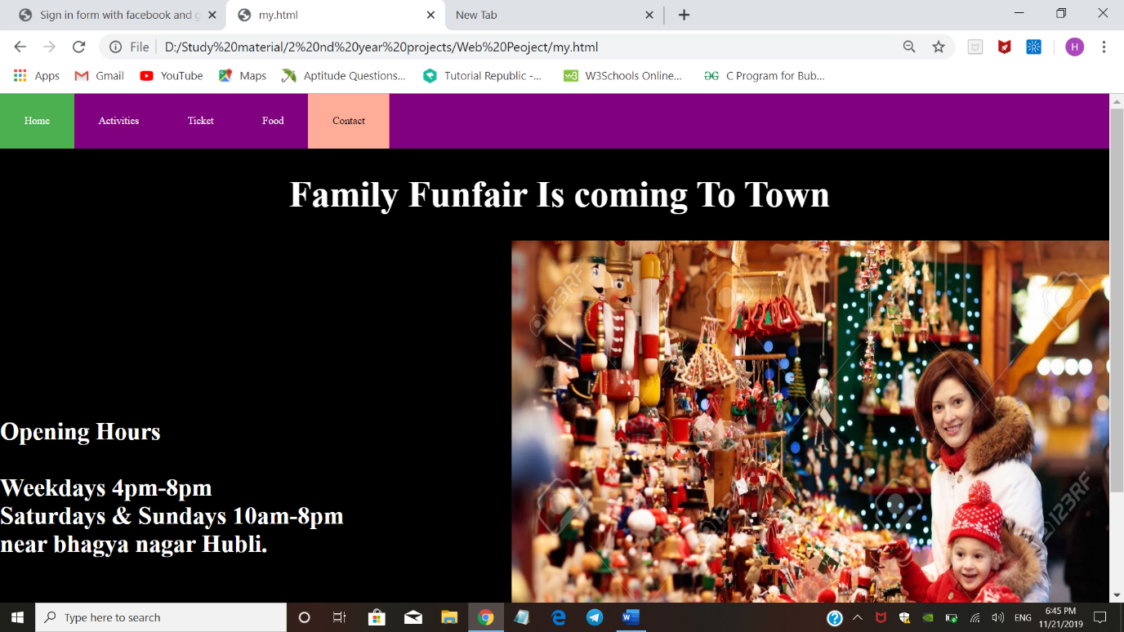
HOME PAGE

